Slide 1

How Machine Learning is applied to Big Data
-Dinesh Kumar P, Product Manager.
-Karthik Sridhar, Tech lead.
Bold BI – Syncfusion Software
“Without data you are just another person with opinion”
- W. Edwards Deming.

Slide 2

Agenda
Where does ‘Big Data' fit in 'Data Science' world?
What would be a day to day routine work of a Data Scientist?
A quick demo + sample use cases of BigData projects like Hadoop, Spark, HBase and Hive.
What is Machine Learning and How it fits in Big Data use cases
Notes:
Can see as story that revolves around the work of a data engineer.
Big Data - is not actually about technology or Software, its THINKING. That also differs case by case and even among companies.

Slide 3
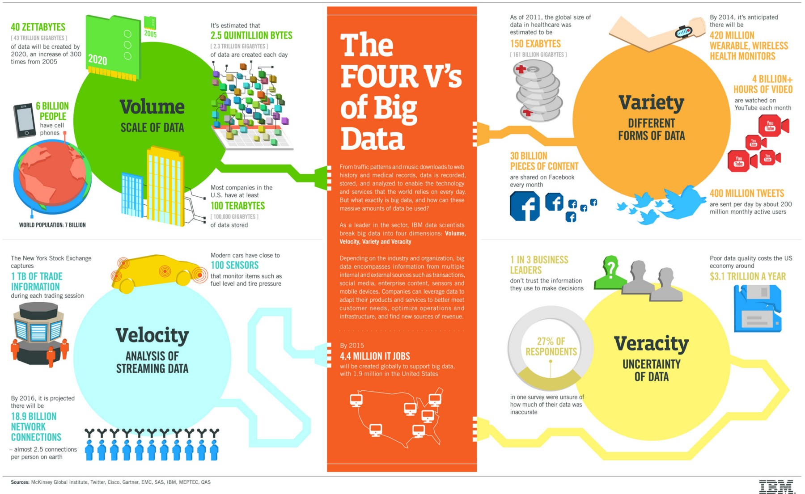
Notes:
Not only for Big Data, can be told for Data science as well.
Velocity will directly impact Volume.
Even though its 1 TB and its velocity is very less, plus the data is of Flat type, then RDBMS itself is a best choice.

Slide 4
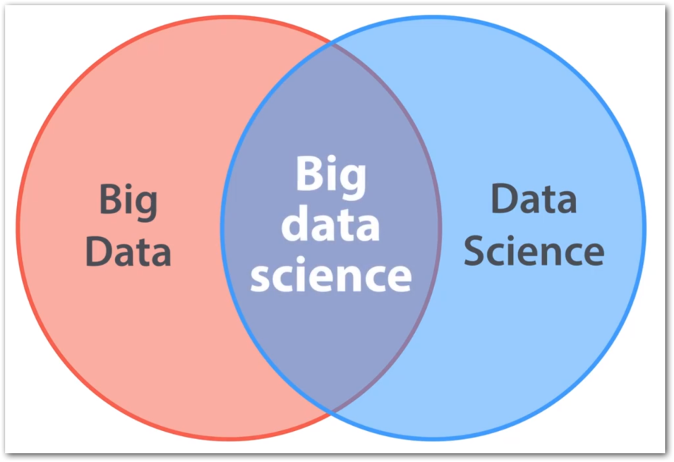
Big Data vs Data Science
Big Data + Data Science = Big Data Science
Big Data ≠ Data Science
Big Data -> All 4 Vs
E.g. Shares trade, E-Shopping
Data Science -> 1 V
E.g. ML use cases like Genetics data, Credit card fraud detection – Volume

Slide 5
Domains, Industries
Marketing
Sales and CRM
Web Analytics
Ecommerce
Advertising
IT
Finance
Healthcare
Social Media
SEO
Banking
Human Resources
Mobile Analytics
Project Management
Research and Development
Support
Survey
Insurance
Manufacturing
Energy
Oil & Gas
Pharmaceuticals
Public Sector
Retail
Communications
Food and Beverages
Education
Media
Technology
Transportation and Logistics
Notes:
Different domains now a days produces different KINDS of data. Upon which all cannot be fit into traditional SQL based database systems.

Slide 6
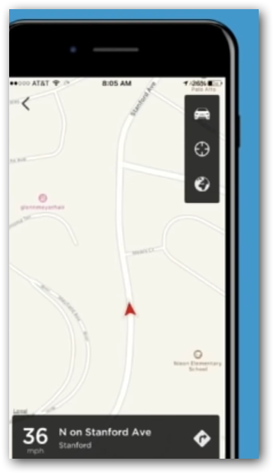
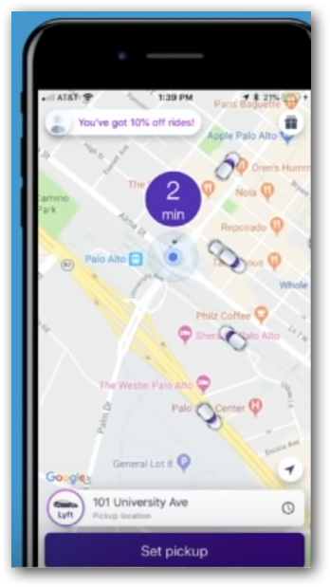
Which one a user would Like?
Where is my driver?
2. When will my driver get here?
Notes:
Data science – With the history of gbs or tbs of trip data, bring up some fact / model that can predict the approximate time
Big Data – Use that model in each and every trip and show the value to user. i.e. Real VALUE that a customer expect.

Slide 7
Which one a user would Like?
Where is my driver?
Just real time.
When will my driver get here?
Real time combined with historical data.
The Business (winning) touch.
Notes:
Data science – With the history of gbs or tbs of trip data, bring up some fact / model that can predict the approximate time
Big Data – Use that model in each and every trip and show the value to user. i.e. Real VALUE that a customer expect.

Slide 8

Why Big Data?
No use of storing data alone, unless we derive some information out of it.
For a business to run successfully - not only its historical data, now a days current data also is necessary.
Showing Recommendation in e-commerce sites.
Cost reduction via commodity hardware.
Empowers to make better decisions analyzing more about their work.
Hadoop – Lot of ecosystem built around it including Spark-HDFS.
Notes:
Cost reduction - Big data technologies such as Hadoop and cloud-based analytics bring significant cost advantages when it comes to storing large amounts of data. (On-premises - Commodity Hardware)

Slide 9
SQL
Vertically Scalable.
Increase the load on a single server by increasing things like CPU, RAM or SSD.
Adding more floors to the same building.
No SQL
Horizontally Scalable.
Can handle more traffic by sharding, adding more servers.
Adding more buildings to the neighborhood.
Notes:
Sharding
Splits large data sets into small data sets across multiple instances.
E.g. Hadoop - distributed cluster architecture.

Slide 10
Why BigData?: SQL Comparision
Hadoop | SQL
Schema on Read | Schema on Write
Master Slave | Client Server
Data stored as like the form of file itself (txt, csv, mp3,…) or compressed form (RC, parquet,..) | Stored as logical forms and inter related columns
Distributed processing across 1000s of nodes. | Not much cluster size at most.
Need to do a lot of effort for quick, real time response that require huge data as well. | Can expect response in milli seconds
E.g. Twitter Hashtag search happen over 1000 servers, ok if miss some tweets due to unavailability of 1 of 60 nodes | E.g. Transaction(Banks), Share market
Notes:
Spark will not suit for 100 MB / 1 GB data
Same way you cannot easily process a semi-structured / un-structured / no-sql data in RDBMS.

Slide 11
Review the customer feedbacks with 3 rating out of 5
Requirement
Build a cost-effective data pipeline system that analyzes customer feedbacks with rating-3 provided in a shopping website.
Prepare a Machine Learning model to know the sentiment of comments mentioned in feedbacks.
Also prepare a visualization that helps stake holders for decision-making.
Notes:
Details - An online shopping site store their feedback data in Azure SQL Data Warehouse. The data, in short, is about the rating(1 to 5) and comments by the buyer for each delivered order. The management would like to extract insights about this feedbacks and improve its business. Analysis of bad feedbacks with 1,2 rating and good feedbacks that are with 4,5 rating is straight forward. Feedbacks with 3-rating expresses the biased feeling of customers with both good and bad comments. So apart from the overall rating, the comments in 3-rating should be segregated as good and bad comments using Machine Learning. Finally need to prepare a business dashboard to showcase the feedbacks for the sake of decision making.

Slide 12
Sentiment Analysis
What drive’s business? – Its “customer satisfaction”.
Online Surveys, Social media posts-tweets-comments, Support requests,…
Sentiment Analysis - the quickest way for decision makers to ask a team to drill down further about feedbacks based on the ratio they get for more data or over a period of time (more bad / more good).
Almost in any domain – Healthcare, Supply Chain apart from just Retail.

Slide 13
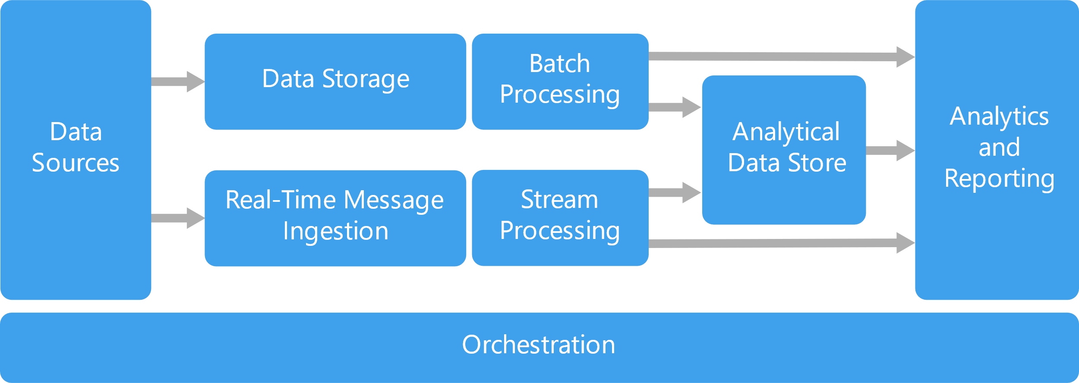

Slide 14
Customer review log files – cloud storage
(Azure Blob / Amazon S3)
Azure Blob
Hadoop, Spark
Microsoft SQL Server
Power BI
Apache Kafka
Spark Streaming
ML Ops

Slide 15
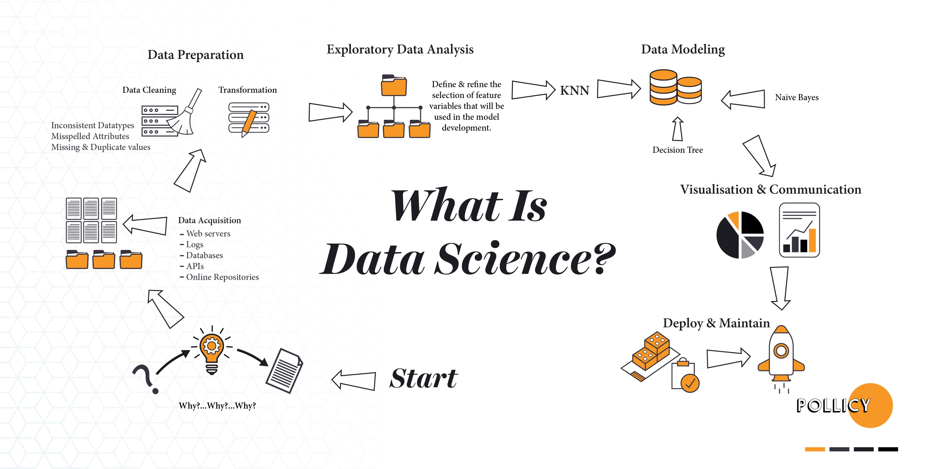

Slide 16

Data engineer’s routine work
2. Identify source(s) of Data
4. Storage & Access
5. Processing
6. Visualization
3. Data Integration
1. Defining Objective

Slide 17

1. Defining Objective
Understand the domain & industry,
Discuss about the business need / problem,
Ask more and more WHYs?
Prepare the objectives.

Slide 18
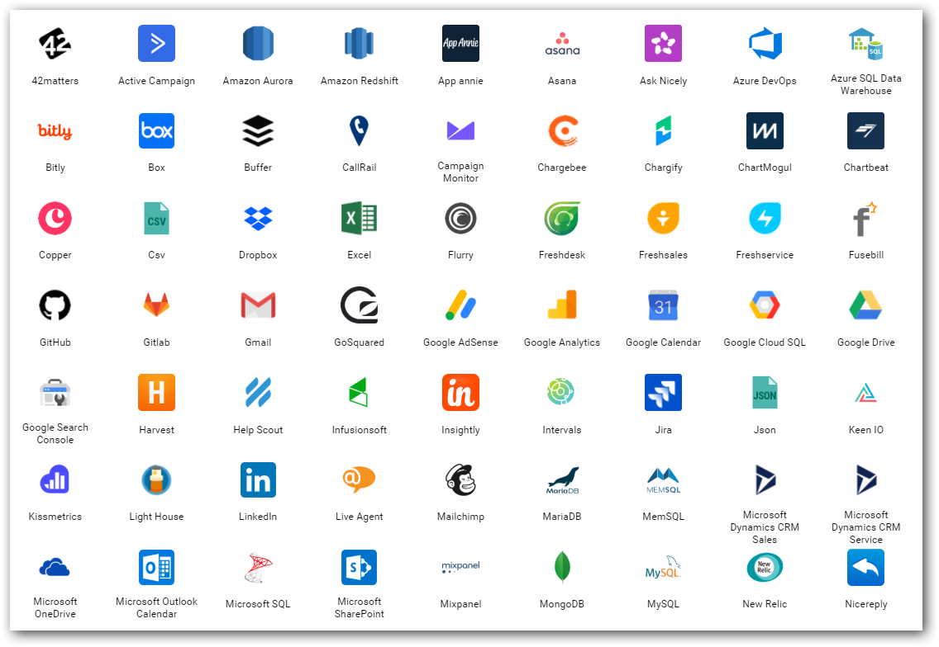
2. Data source(s)
Find out from where you need to get the data for your project.
Either provided or should search and find.
Logs
Databases
Web (REST APIs)
Social Media
…
Notes:
Logs – NASA logs which we gonna process.

Slide 19
3. Data Integration
Required data would exist in different sources those need to be brought to one place for,
Gather
Clean
Prepare
Tools
Apache Sqoop
Informatica
Apache Nifi…

Slide 20
4. Storage & Access
Different stages
Initial
Processing
Final
Instances & Services
Cloud Database instances (SQL Server, MySQL,..)
Amazon S3
Azure Blob / Azure Data Lake…
Access
API
Integration between processing tools

Slide 21
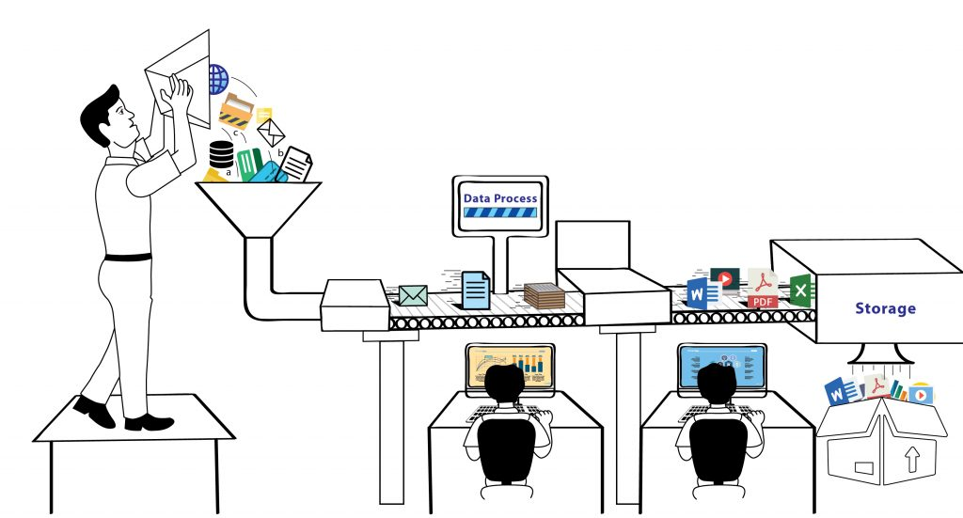
5. Process
Analyze / Do Analytics
ML models
Map Reduce
Tools & Services
Apache Pig / Hive / Spark
Amazon Sage Maker
Azure HDInsight / Databricks / ML Studio

Slide 22
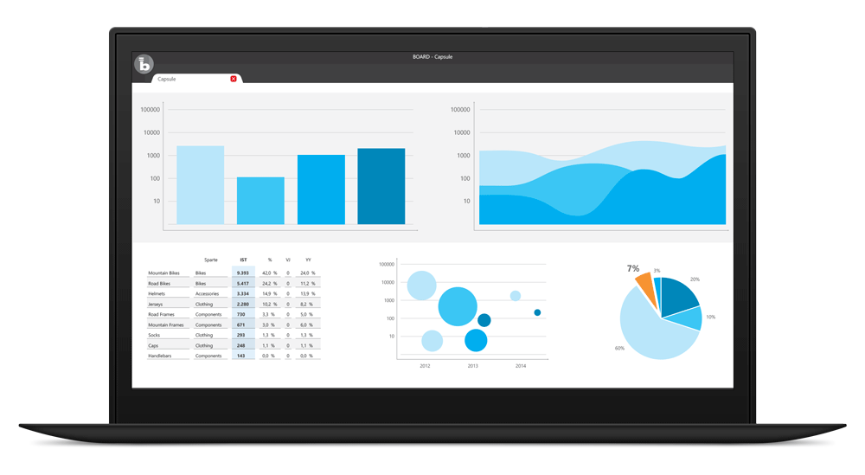
6. Visualize
BI tools for business decisions
Microsoft Power BI
Tableau
Qlik
Bold BI
…
In-built packages in R, Python
Notes:
Most important.
This is how the top cream layer gets the view of their business that leads to decisions.

Slide 23

Importance of Business Intelligence and Visualization
How to convey your boss with data in Excel with thousands of rows?
Just convey it as a bar chart / pie chart.
Transform the data into charts, images,… that explain the numbers and allow us to get insights from it.
Meaning and purpose to the original data.
See the story that lives in your data.
Discover patterns (HISTORY), metrics (CURRENT) and spot trends (FUTURE).

Slide 24
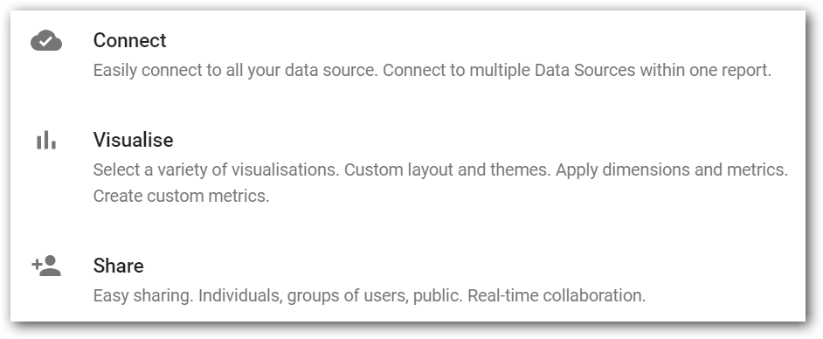

Slide 25
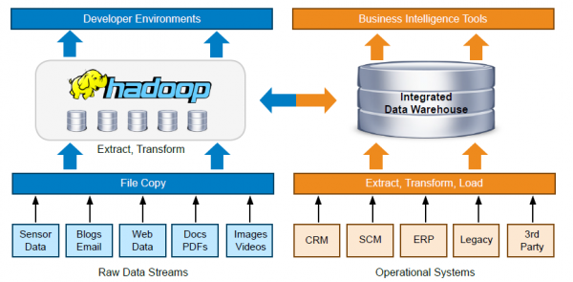
Notes:
A typical tool set and workflow architecture of a Data team

Slide 26
Big Data projects
Notes:
We can just have a overview of major BigData projects that has been around in market for few years and still being used.
Also we can have a quick demonstration of them using a windows based tool – Syncfusion Big Data Studio.

Slide 27

Apache Hadoop
* PROCESS and STORE data in a distributed computing environment (commodity hardware).
* Fault tolerant (Data & Processing)

Slide 28

Apache Hive
* HIVE is a data warehousing component originated @Facebook.
* Hive Query Language(HQL) - very similar like SQL.
* 2 wide spread clients - Hive Command Line and JDBC/ODBC driver.

Slide 29

Apache HBase
* A non-relational column oriented distributed database that runs on top of HDFS.
* Simply say, NoSQL on top of Hadoop.
* Provides real-time read/write access to large datasets. i.e. Over comes random writes, which HDFS does not support.

Slide 30

Apache Sqoop
* Transfer data between Hadoop and relational databases.
* Can handle large size as well and can be parallelized to increase the pace of work.
* Works with several relational databases such as MS SQL Server, Teradata, Netezza, Oracle, MySQL, Postgres.

Slide 31

Apache Oozie
* It is a workflow scheduler system to manage Big Data jobs.

Slide 32

Apache Spark
* Apache Spark is a framework for real time data analytics in a distributed computing environment.
* Spark is written in Scala and was originally developed at the University of California, Berkeley.
* It executes in-memory computations to increase speed of data processing over Map-Reduce.
* Supported APIs – Scala, Python, R, Java.
* Libraries – SQL, Streaming, Machine Learning and Graph.

Slide 33
Play Time !! Big Data Studio

Slide 34
What is Machine Learning ?
Looking for patterns in Data
Generate Code
Recognize those pattern in new Data

Slide 35
What Machine Learning does ?
Enter Text
Predicting future
Organizing or Grouping

Slide 36
Features vs Labels
Enter Text
Features
Input
Labels
Output
OverAll, Vote, Review_Time, Product, Review_Text, Summary
Good/Bad

Slide 37
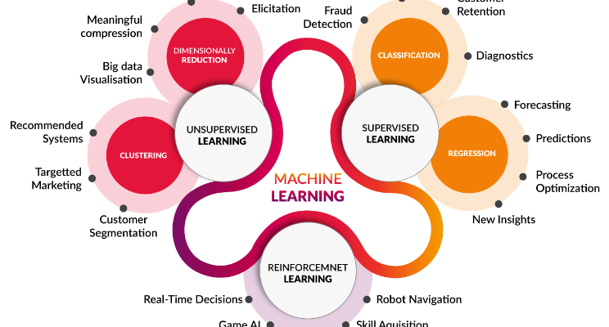
Types of algorithms
Enter Text
Notes:
Error from sensitivity to small fluctuations(Including anomaly) . Overfitting

Slide 38
Five Questions
Enter Text
1. Is this A or B ?
2. Is this Weird ?
3. How much or many ?
4. How this is organized ?
5. What should I do next ?
Notes:
Classification.
Anomaly Detection.
Regression.
Clustering.
Reinforcement.

Slide 39
Can you Answer?
Is it a Cat or Dog?
COVID-19 confirmed cases in Antartica is crossing 1000.
Organize the Email as Social, Promotion, Primary
Is the incoming email a spam?
Should turn left or right?

Slide 40
Big Data Hype
Companies were selling Big Data solutions as a silver bullet solution to all the enterprises’ problems.
For a use case using Hive+Oozie didn’t provided expected result. Butworked better with MySQL+Cron.
There was no ideal approach like below;
Client - “I want to implement a Big Data solution”
Consultant- “That could be the solution, but let us discuss the problem first”.
Notes:
My opinion - Ecosystem projects are not growing to be compatible with Hadoop. E.g. Pig, Sqoop, Oozie,…

Slide 41
Kafka and Spark
Streaming platform’s necessity.
Hadoop made fast.

Slide 42
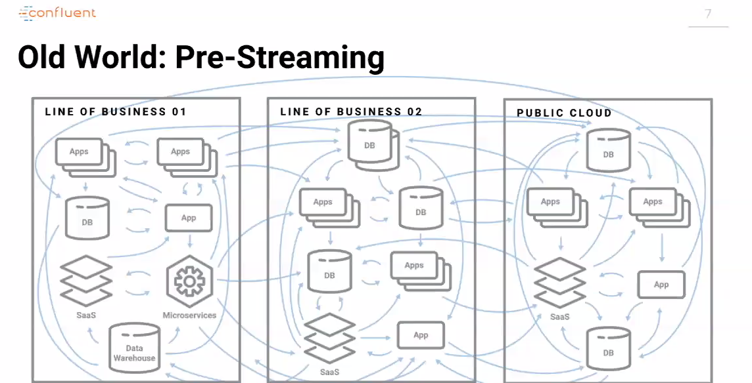

Slide 43
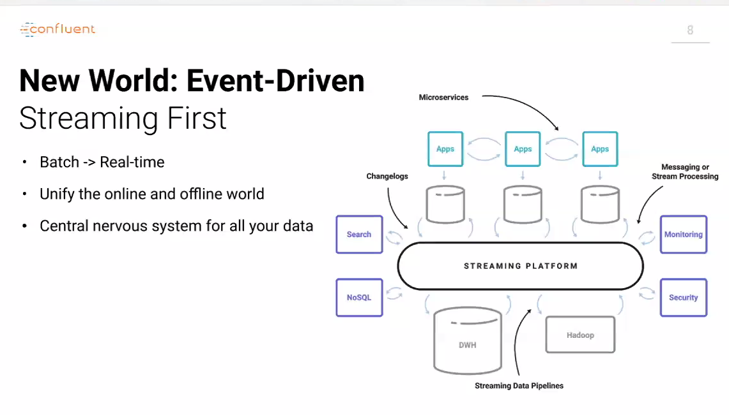

Slide 44
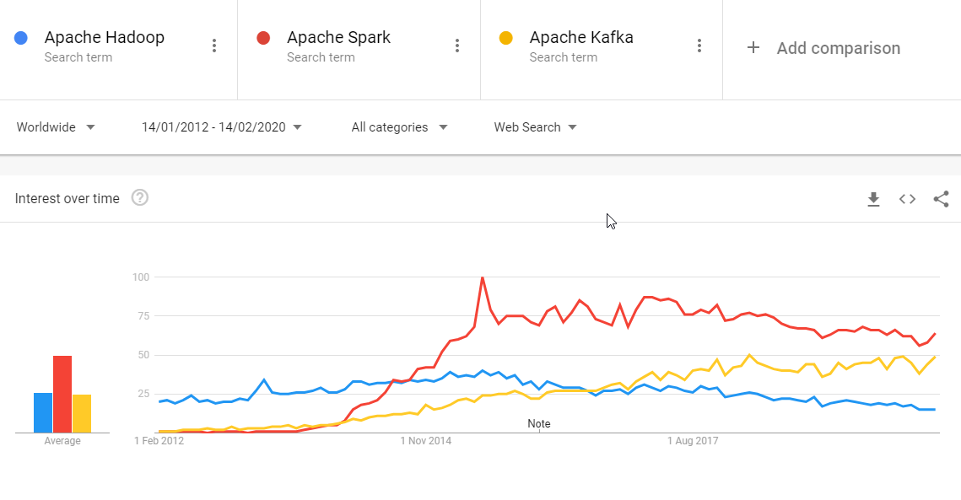
Notes:
https://trends.google.com/trends/explore?date=2012-01-14%202020-02-14&q=Apache%20Hadoop,Apache%20Spark,Apache%20Kafka

Slide 45
Cloud services
Storage – HDFS –> Azure Data Lake...
Processing – Map Reduce –> Azure Kubernetes cluster, Azure Synapse Analytics, Azure Databricks...
Resources elasticity -> Create as you go via Automation scripts (Powershell, Ansible). That too Synapse take care of resource computation by itself “server as service”.

Slide 46
Cloud Burst
Allowed to be conservative in investments.
Crawl before you walk and walk before you run.
Elasticity both for Storage and Processing.

Slide 48
Books & Movies
Enter Text
Cartoon Introduction to Statistics
Thinking Fast & Slow by Daniel Kaheman
Art of thinking clearly – Rolf Dobelli
I-Robot
Terminator 2
Notes:
I-Robot
Terminator 2

Slide 49
Questions ??

